Slide 1
Guaiacol Uptake Curves
Manny and Michelle’s paper

Slide 2
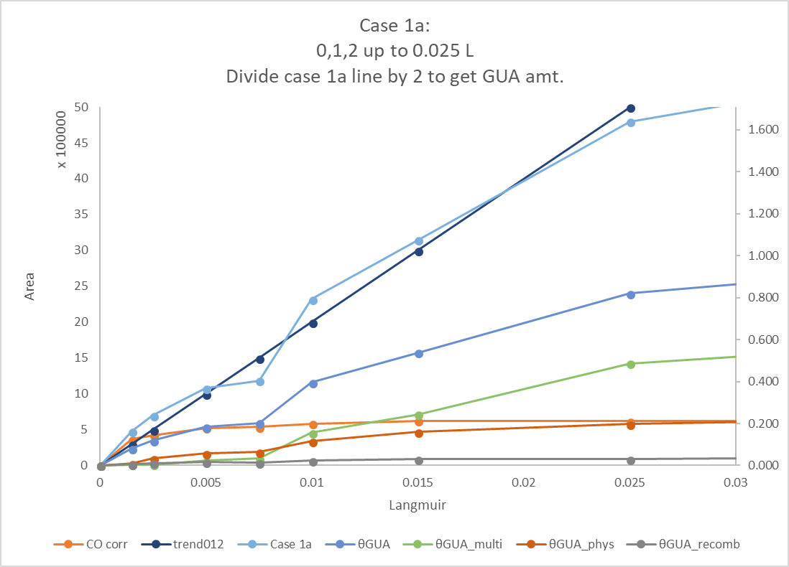
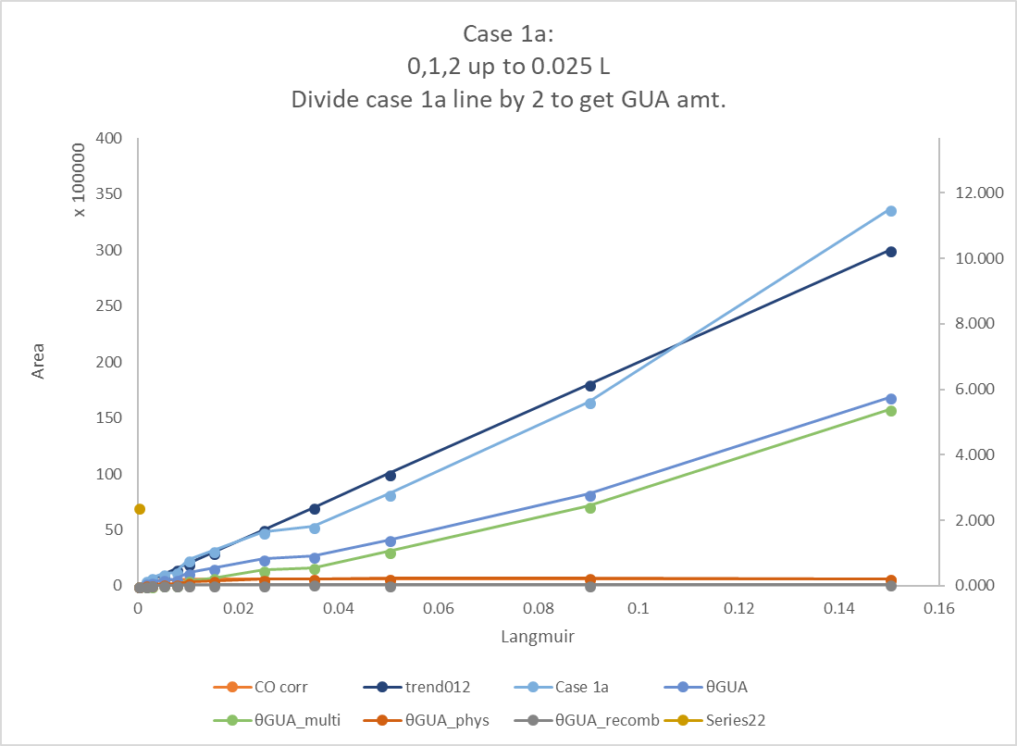
Case 1: Zero/Optimized for small doses θ = 0.54, 7.5 ML at 0.015 L when CO saturates

Slide 3
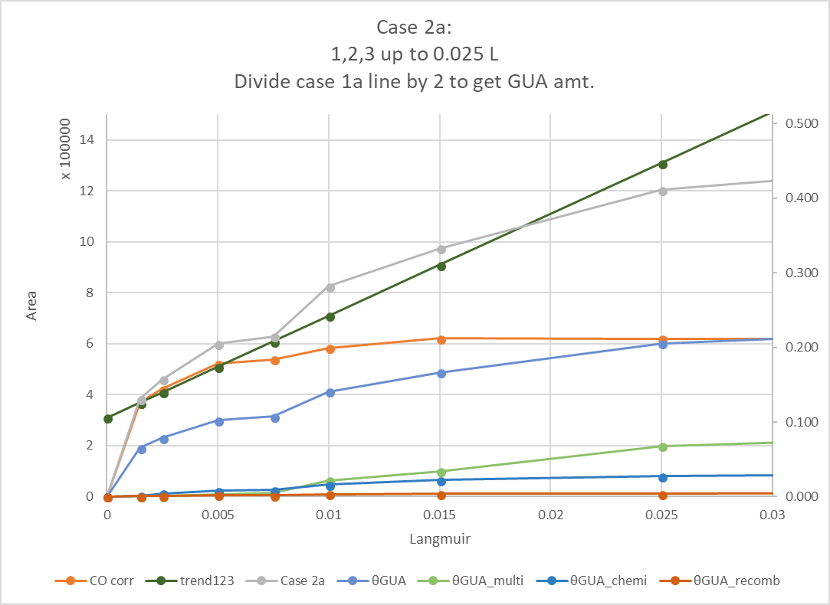
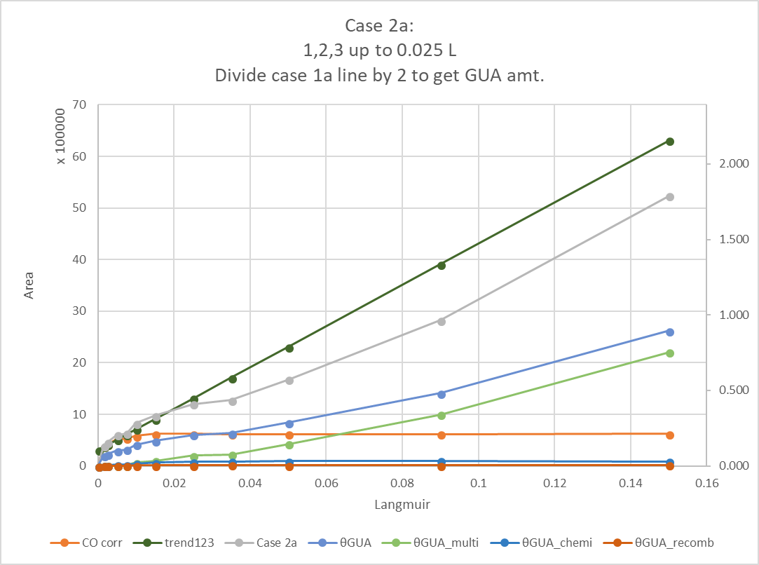
Case 2: Nonzero/Optimized for small doses θ = 0.17, 2.21 ML at 0.015 L when CO saturates
We like this one!

Slide 5
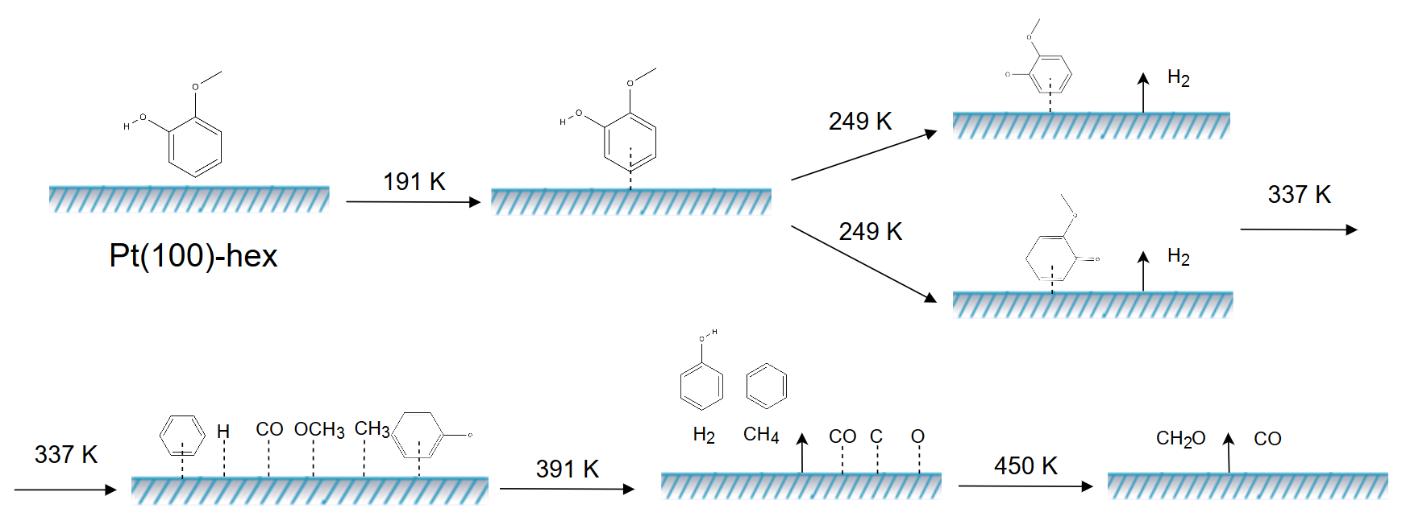
Scheme

